Slide 1
Electrical Circuits Lecture 4: Handy Circuit Analysis Techniques By: Mahmoud Momtazpour ceit.aut.ac.ir/~momtazpour
Amirkabir University of Technology

Slide 2
Topic Overview
Handy Circuit Analysis Techniques
Superposition Concept
Practical Source
Source Transformation
Thevenin/Norton Circuits
Δ-Y Conversion

Slide 3
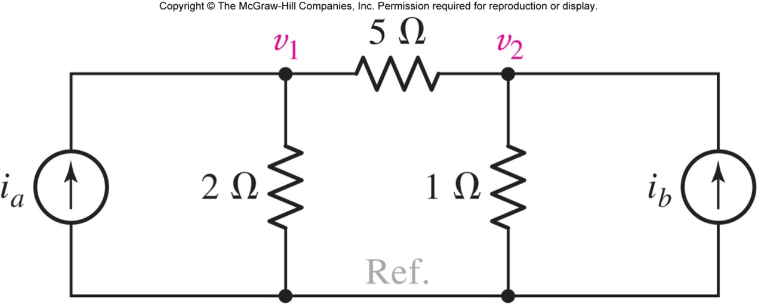
The Superposition Concept
For the circuit shown, the solution can be expressed as:
Question: How much of v₁ is due to source A, and how much is because of source B?
We use the superposition principle to answer.

Slide 4
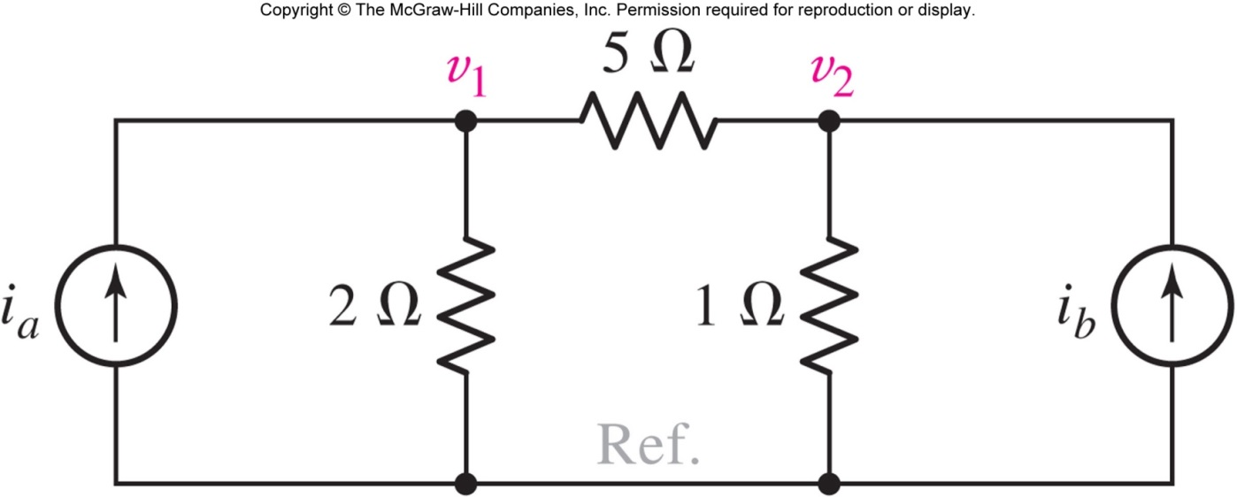
The Superposition Concept
If we define A as
then
Superposition:
the response is the sum of experiments A and B.
Experiment B
Experiment A

Slide 5
The Superposition Theorem
In a linear network, the voltage across or the current through any element may be calculated by adding algebraically all the individual voltages or currents caused by the separate independent sources acting “alone”, i.e. with
all other independent voltage sources replaced by short circuits and
all other independent current sources replaced by open circuits.
Answer: i₃(t) = 1.333 sin t V

Slide 6
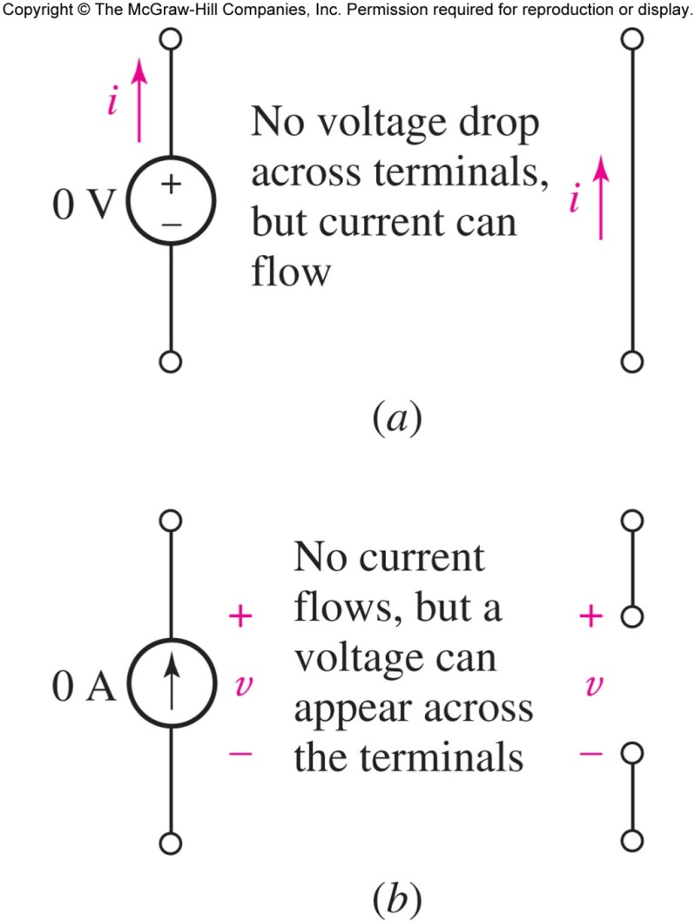
Applying Superposition
Leave one source ON and turn all other sources OFF:
voltage sources: set v=0.
These become short circuits.
current sources: set i=0.
These become open circuits.
Find the response from this source.
Add the resulting responses
to find the total response.

Slide 7
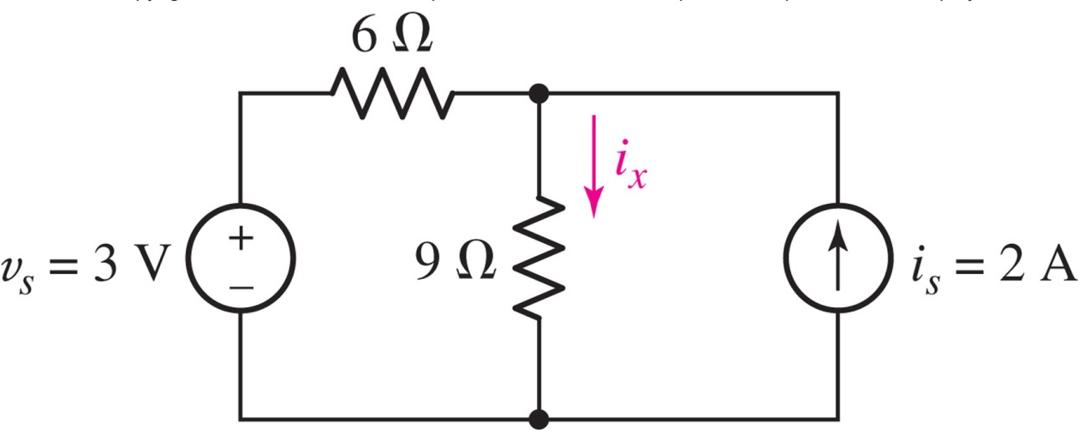
Superposition Example (part 1 of 4)
Use superposition to solve for the current i_{x}

Slide 8
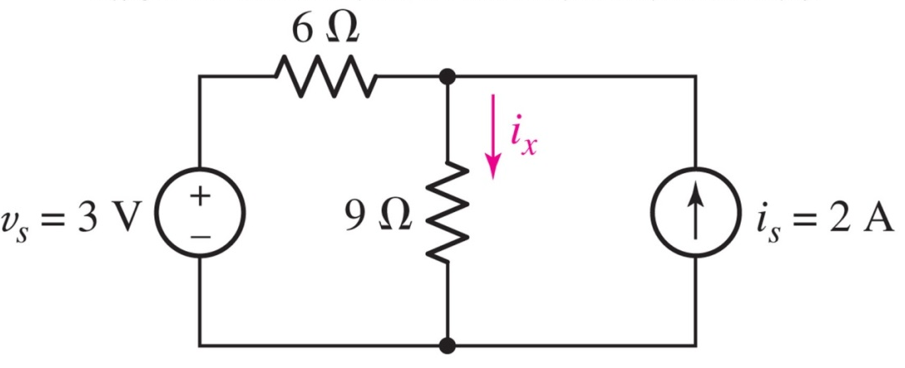

Superposition Example (part 2 of 4)
First, turn the current source off:

Slide 9
Superposition Example (part 3 of 4)
Then, turn the voltage source off:

Slide 10
Superposition Example (part 4 of 4)
Finally, combine the results:

Slide 11
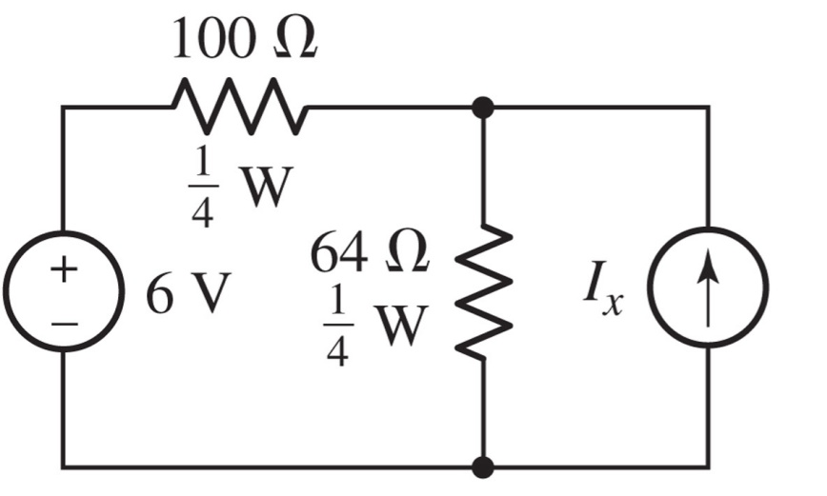
Example: Power Ratings
Determine the maximum positive current to which the source I_{x} can be set before any resistor exceeds its power rating.
Answer: I_{x}<42.49 mA

Slide 12
Example: Power Ratings

Slide 13
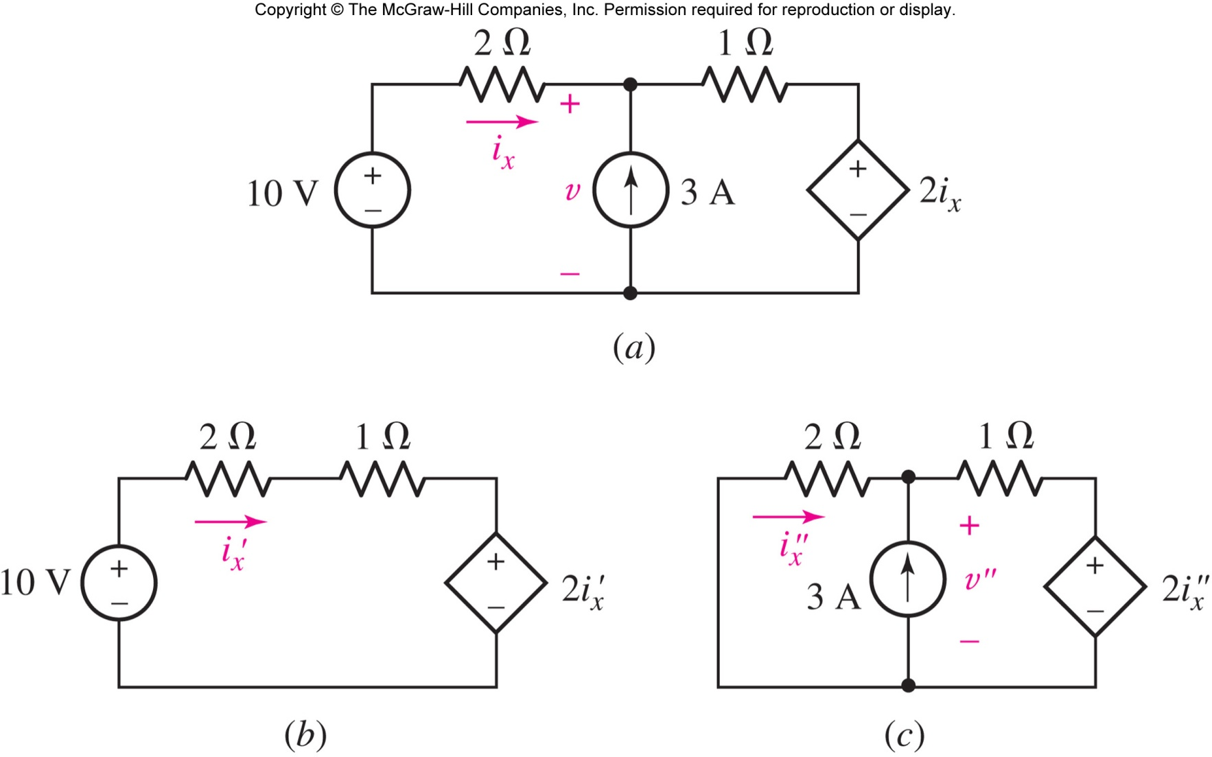
Superposition with a Dependent Source
When applying superposition to circuits with dependent sources, these dependent sources are never “turned off.”

Slide 14
Superposition with a Dependent Source
current source off
voltage source off
i_{x} = i_{x}’+i_{x}’’= 2 + (−0.6) = 1.4 A

Slide 15
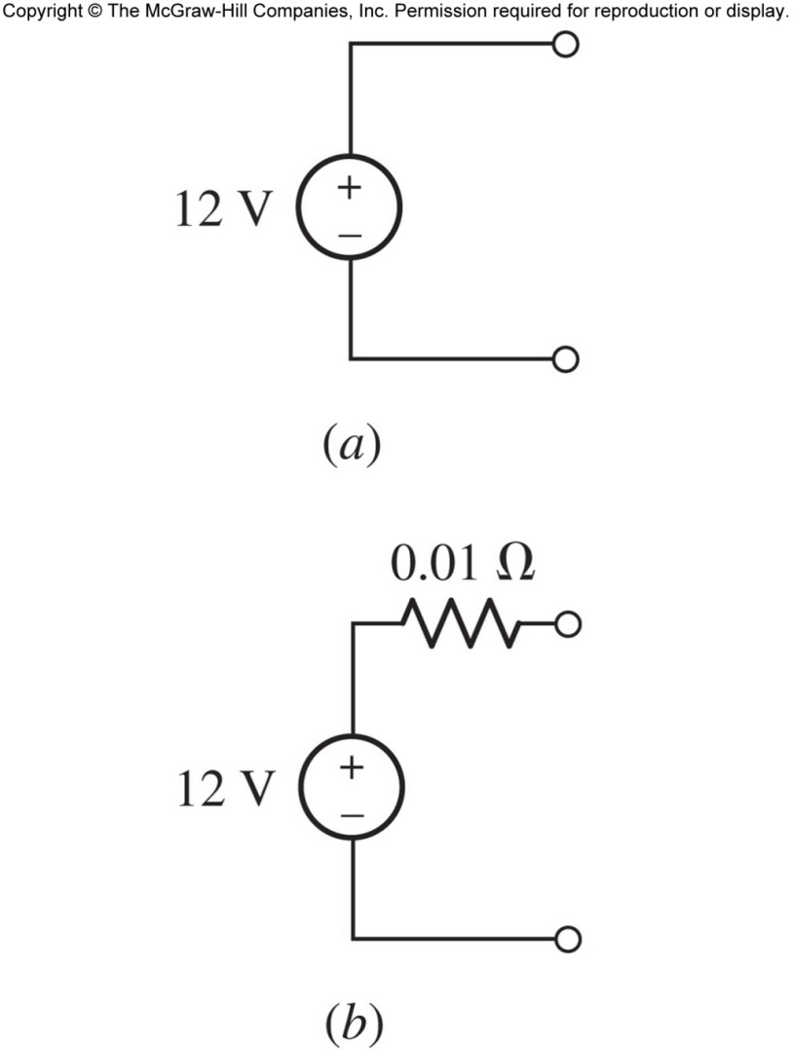
Practical Voltage Sources
Ideal voltage sources: a first approximation model for a battery.
Why do real batteries have a current limit and experience voltage drop as current increases?
Two car battery models:

Slide 16
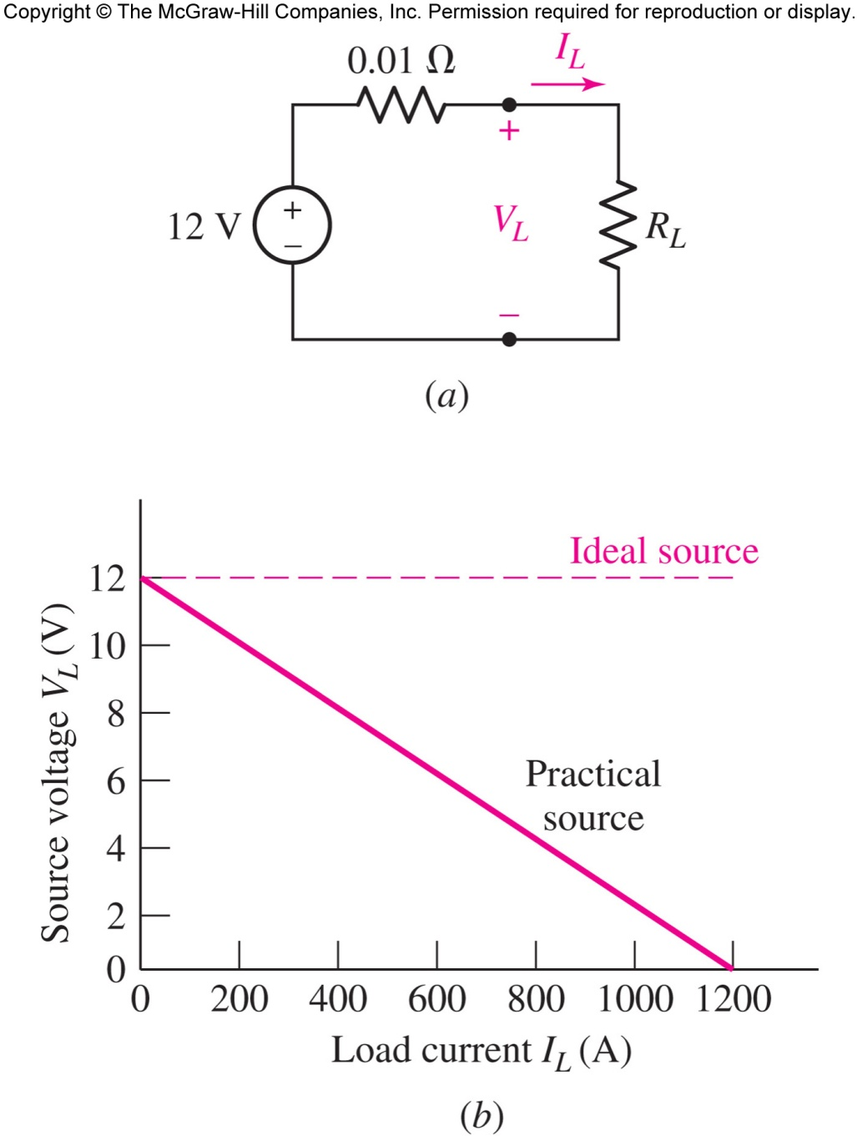
Practical Source: Effect of Connecting a Load
For the car battery example:
V_{L} = 12 – 0.01 I_{L}
increase R_{L}
This line represents all possible R_{L}

Slide 17
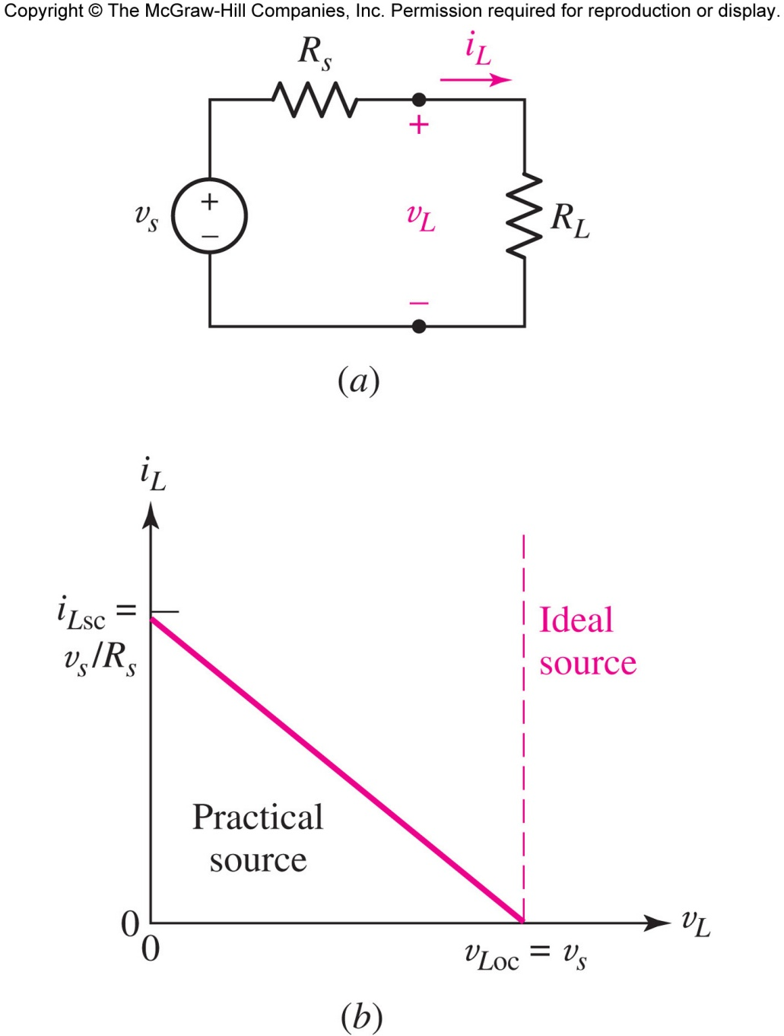
Practical Voltage Source
The source has an internal resistance or output resistance, which is modeled as R_{s}
short circuit current (when R_{L}=0)
open circuit voltage (when R_{L}=∞)

Slide 18
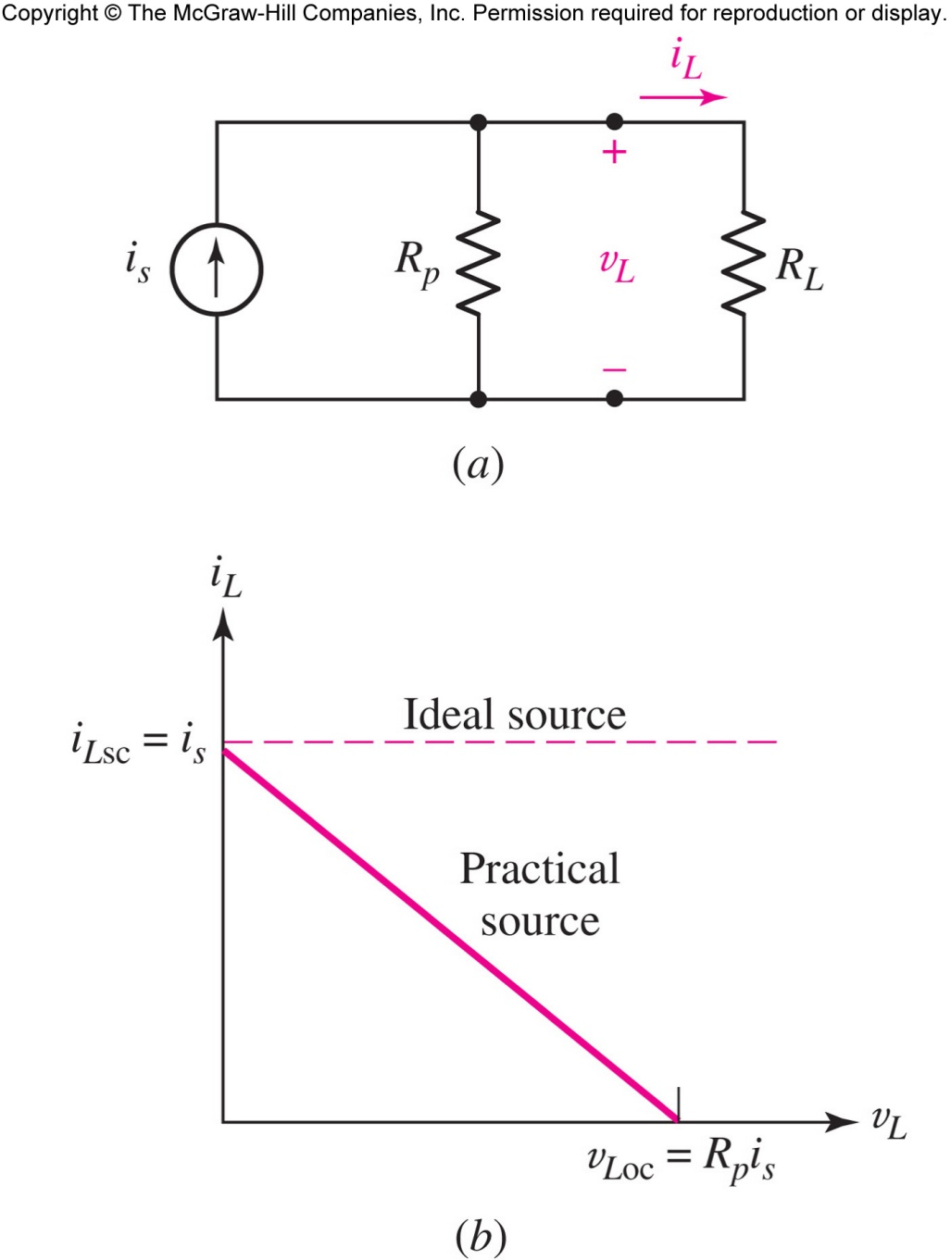
Practical Current Source
The source has an internal parallel resistance which is modeled as R_{p}
short circuit current (when R_{L}=0)
open circuit voltage (when R_{L}=∞)

Slide 19
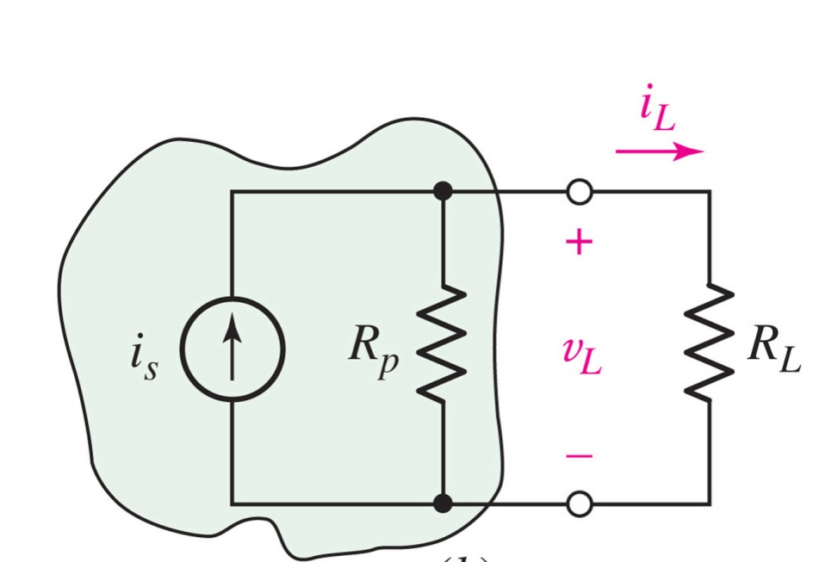

Source Transformation and Equivalent Sources
The sources are equivalent if?
R_{s}=R_{p} and v_{s}=i_{s}R_{s}

Slide 20
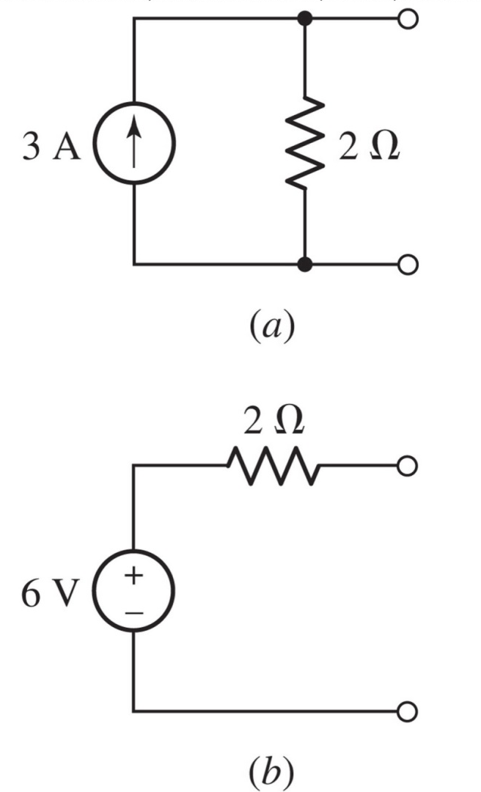
Source Transformation
The circuits (a) and (b) are equivalent at the terminals.
If given circuit (a), but circuit (b) is more convenient, switch them!
This process is called
source transformation.

Slide 21
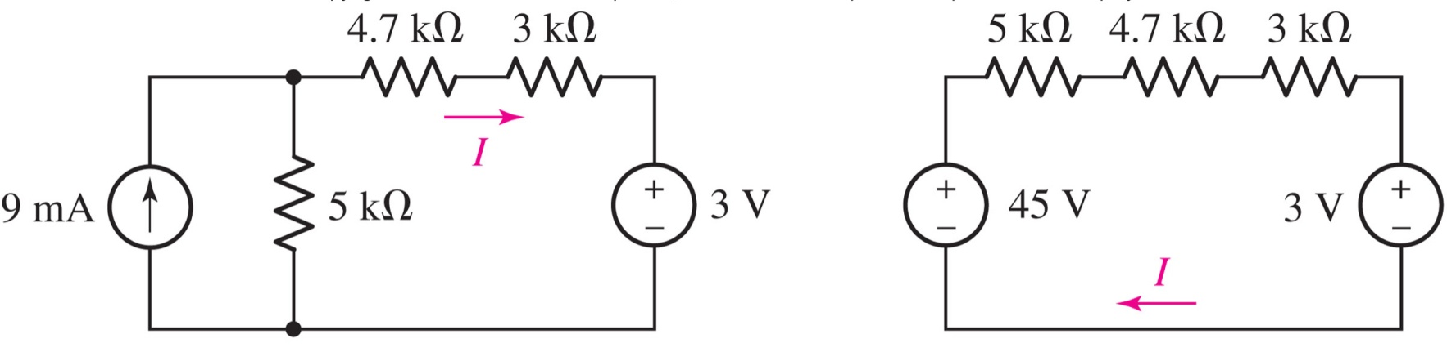
Example: Source Transformation
We can find the current I in the circuit below using source transformation, as shown.
I = (45-3)/(5+4.7+3) = 3.307 mA

Slide 22
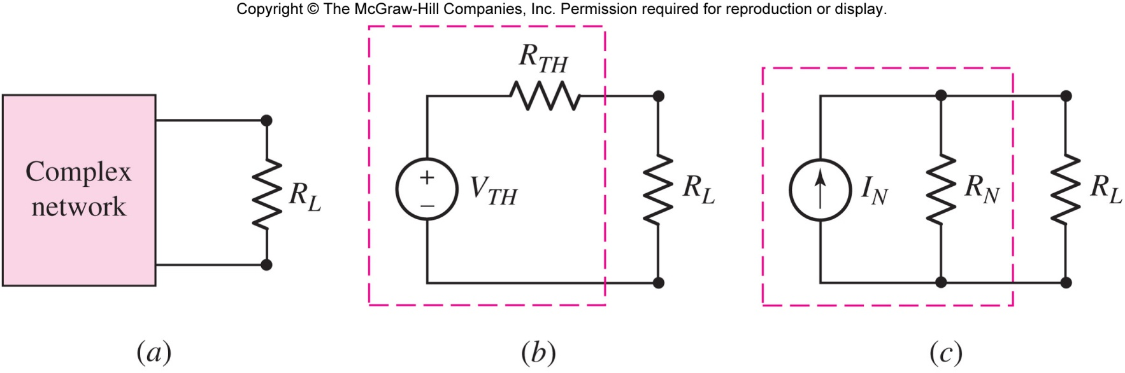
Thévenin Equivalent Circuits
Thévenin’s theorem: a linear network can be replaced by its Thévenin equivalent circuit, as shown below:

Slide 23
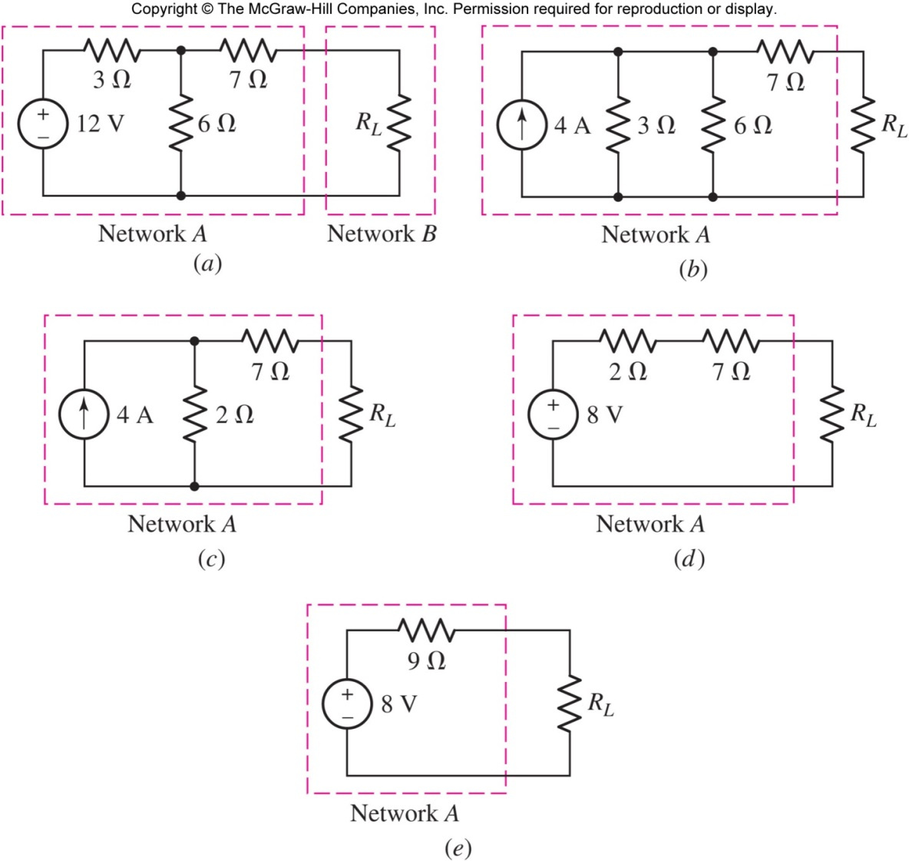
Thévenin Equivalent using Source Transformation
We can repeatedly apply source transformation on network A to find its Thévenin equivalent circuit.
This method has limitations- not all circuits can be source transformed.

Slide 24
Finding the Thévenin Equivalent
Disconnect the load.
Find the open circuit voltage v_{oc}
Find the equivalent resistance R_{eq} of the network with all independent sources turned off.
Then:
V_{TH}=v_{oc} and
R_{TH}=R_{eq}

Slide 25
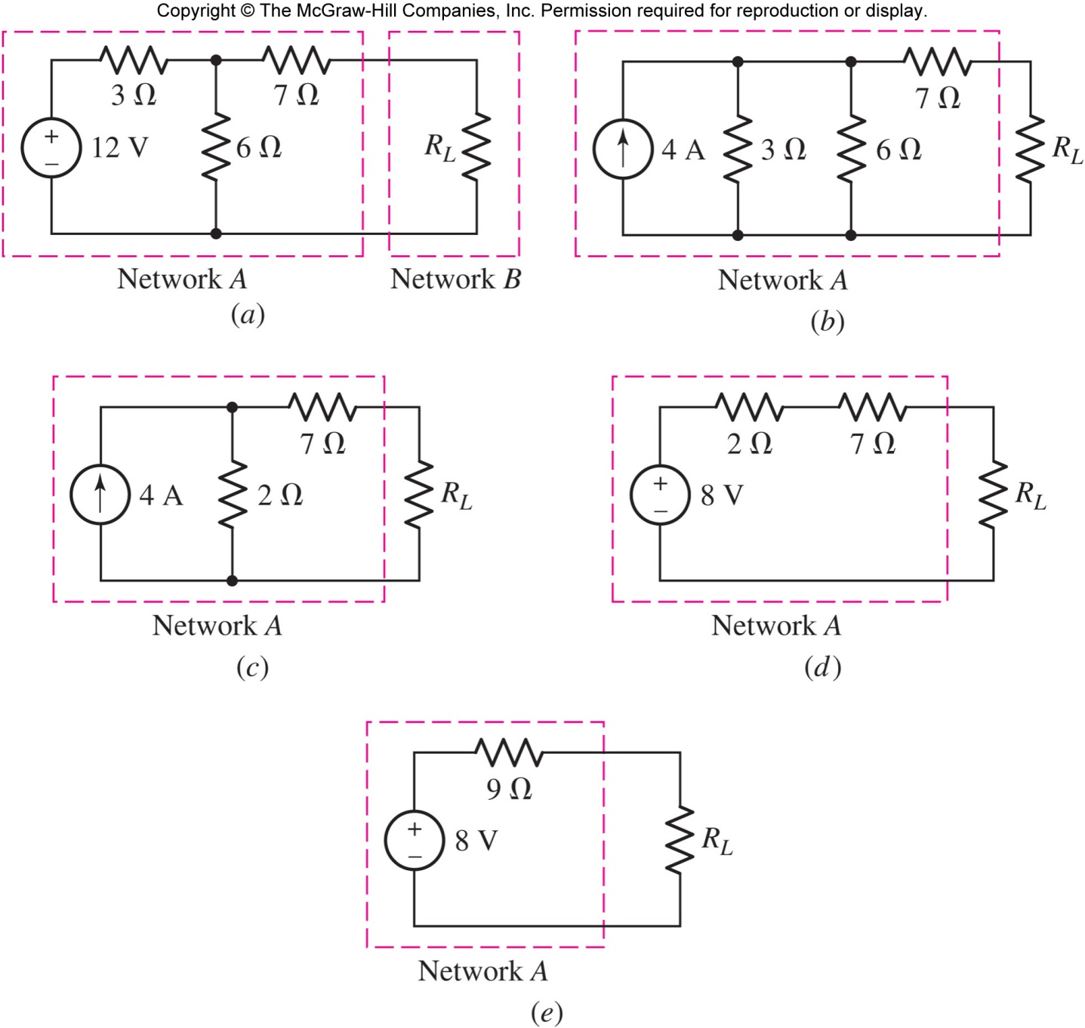
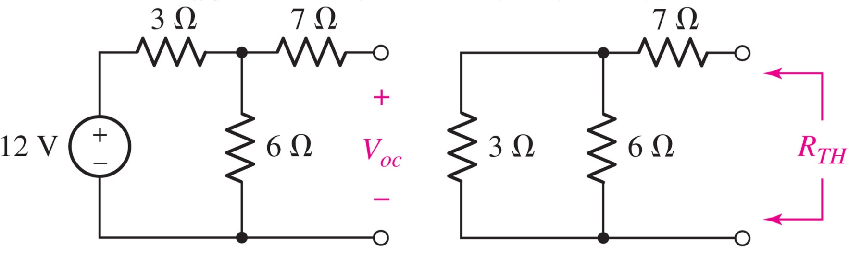
Thévenin Example

Slide 26
Norton Equivalent Circuits
Norton’s theorem: a linear network can be replaced by its Norton equivalent circuit, as shown below:

Slide 27
Finding the Norton Equivalent
Replace the load with a short circuit.
Find the short circuit current i_{sc}
Find the equivalent resistance R_{eq} of the network with all independent sources turned off.
Then:
I_{N}=i_{sc} and R_{N}=R_{eq}

Slide 28
Source Transformation: Norton and Thévenin
The Thévenin and Norton equivalents are source transformations of each other!
R_{TH}=R_{N} =R_{eq} and v_{TH}=i_{N}R_{eq}

Slide 29
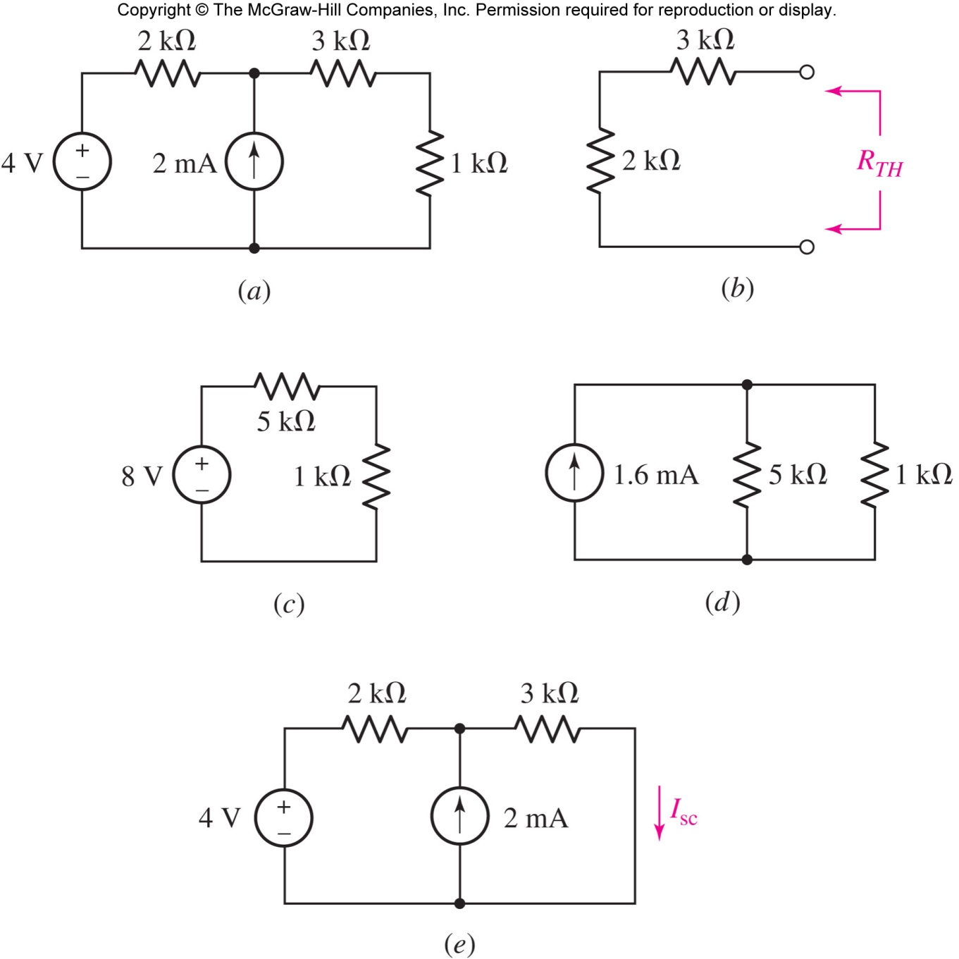
Example: Norton and Thévenin
Find the Thévenin and Norton equivalents for the network faced by the 1-kΩ resistor.
Answer: next slide
the load resistor
this is the circuit we will simplify

Slide 30
Example: Norton and Thévenin
Thévenin
Norton
Source Transformation

Slide 31
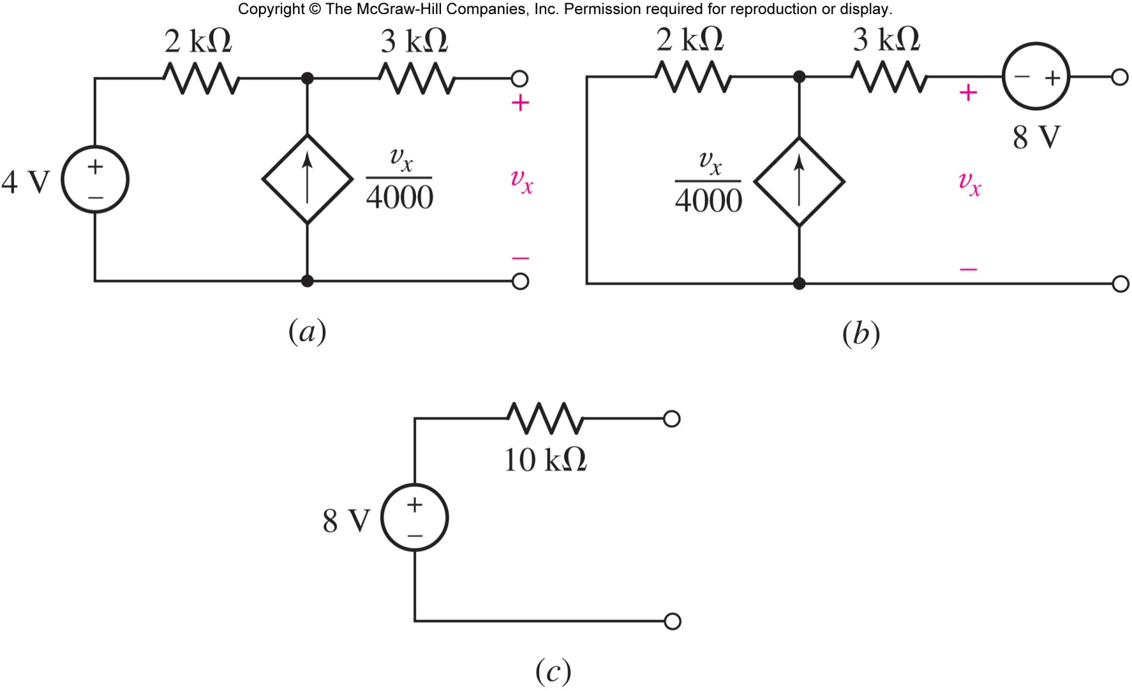
Thévenin Example: Handling Dependent Sources
One method to find the Thévenin equivalent of a circuit with a dependent source: find V_{TH} and I_{N} and solve for R_{TH}=V_{TH} / I_{N}
Example:

Slide 32
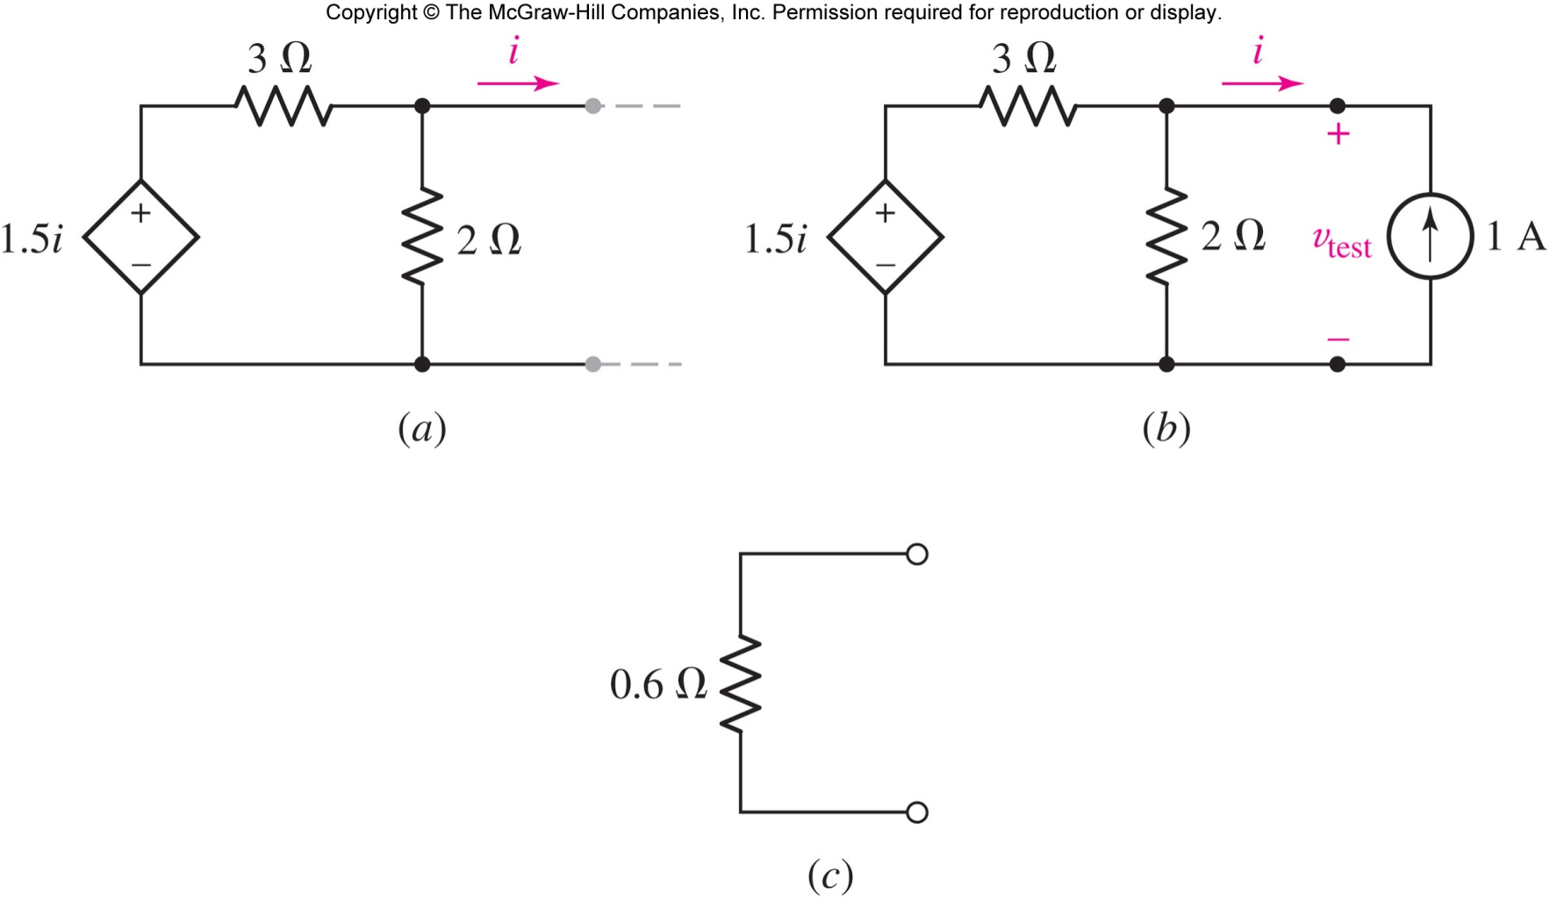
Thévenin Example: Handling Dependent Sources
Finding the ratio V_{TH} / I_{N} fails when both quantities are zero!
Solution: apply a test source.

Slide 33
Thévenin Example: Handling Dependent Sources
Solve: v_{test} =0.6 V, and so R_{TH} = 0.6 Ω

Slide 34
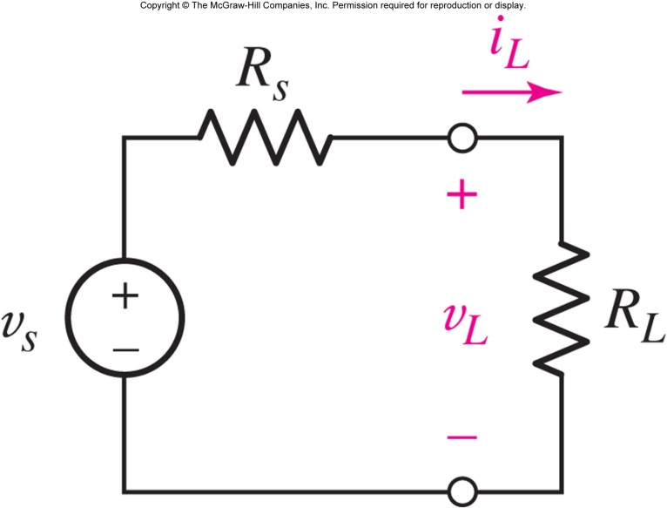
Maximum Power Transfer
What load resistor will allow the practical source to deliver the maximum power to the load?
Answer: R_{L}=R_{s}
[Solve dp_{L}/dR_{L}=0.]
[Or: p_{L}=i(v_{s}-iR_{s}), set dp_{L}/di=0 to find i_{max}=v_{s}/2R_{s}. Hence R_{L}=R_{s}]

Slide 35
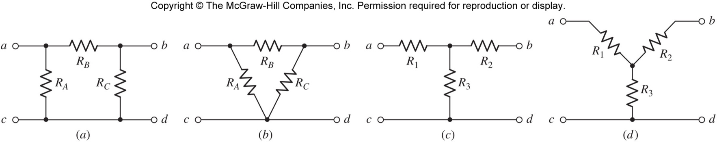
Δ-Y (delta-wye) Conversion
The following resistors form a Δ:
The following resistors form a Y:

Slide 36
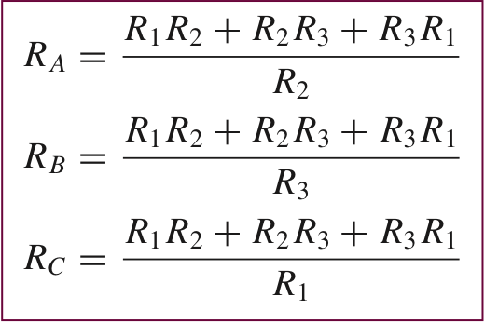
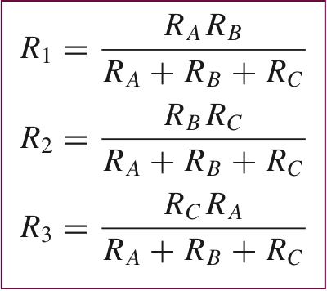
Δ-Y (delta-wye) Conversion
this Δ is equivalent to the Y if
this Y is equivalent to the Δ if

Slide 37
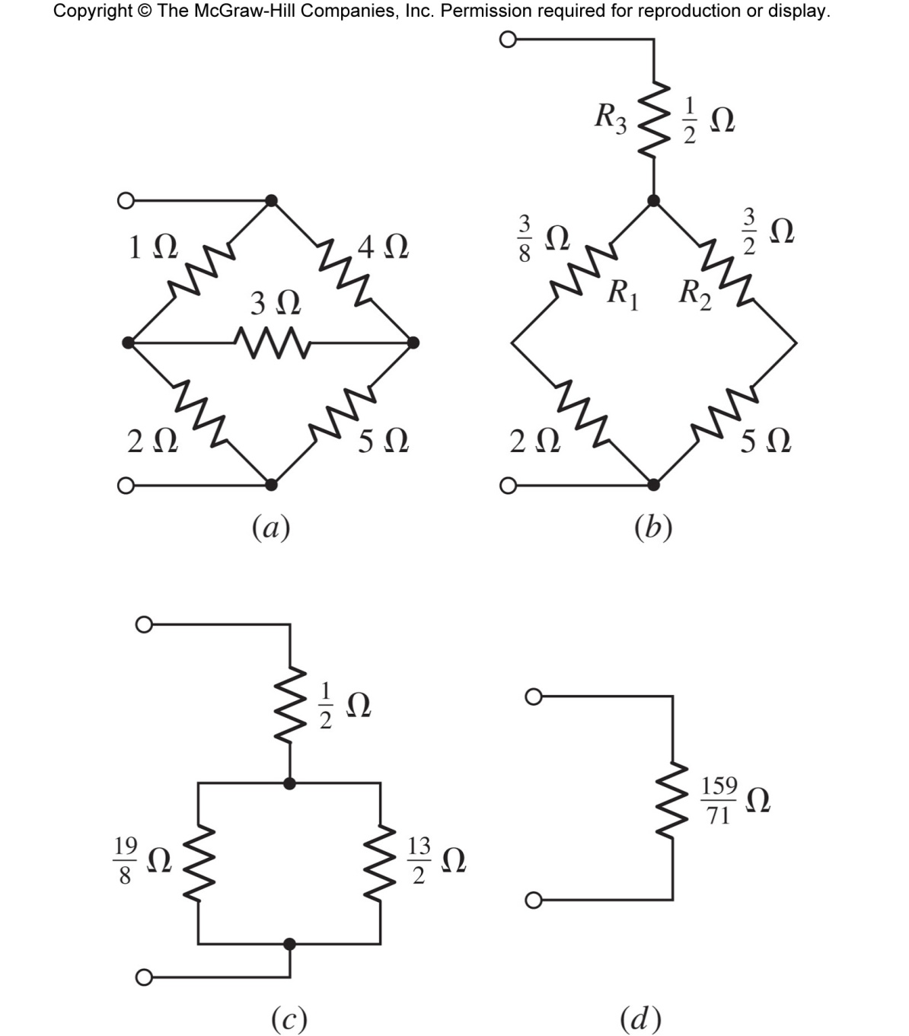
Example: Δ-Y Conversion
How do we find the equivalent resistance of the following network? Convert a Δ to a Y

Slide 38
Example: Δ-Y Conversion
use the Δ to Y equations
use standard serial and parallel combinations

Slide 39
Summary
Can you explain these terms?
Superposition Concept
Practical Source
Source Transformation
Thevenin/Norton Circuits
Δ-Y Conversion
Can you use them to simplify the analysis?

Slide 40
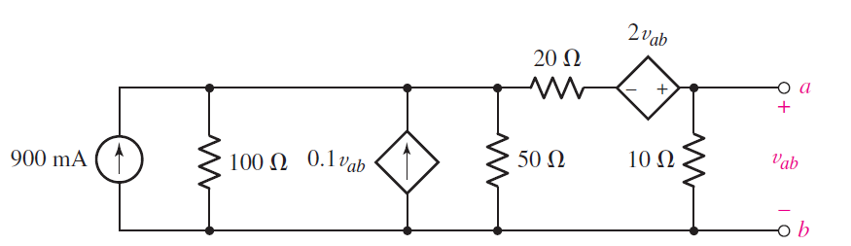
In-class Exercise
Find maximum power of R_{L} if it is connected across a and b terminals. What would be the value of R_{L} itself?

